Slide 1



HIV Cure Research in Women
Thumbi Ndung’u, BVM, PhD
Investigator, Africa Health Research Institute (AHRI)
Professor and Director, HIV Pathogenesis Programme (HPP), Doris Duke Medical Research Institute
Nelson R. Mandela School of Medicine
University of KwaZulu-Natal
IAS HIV Cure Research with the Community workshop
Pre-Conference Meeting, RAI, Amsterdam, Netherlands 21 July June 2018

Slide 2
Disclosures
Thumbi Ndung’u has received HIV cure research grant funding from Gilead Sciences, Inc

Slide 3
Current prevention and treatment strategies are suboptimal and possibly unsustainable
cART
toxicity
Male circumcision
Treatment of STIs
HIV
ageing
HIV
PREVENTION STRATEGIES
Treatment for prevention
HIV Counselling and Testing
Cardiovascular disease
Metabolic disorders
Neurocognitive abnormality
Reduced life expectancy, etc
Oral pre (and post)-exposure prophylaxis
Behavioural interventions
Volberding and Deeks, Lancet, 2010.
ART cohort collaboration, Clin Infect Dis, 2010.
Lohse et al., Ann Int Med., 146: 87
ART cohort collaboration, Clin Infect Dis 2017

Slide 4
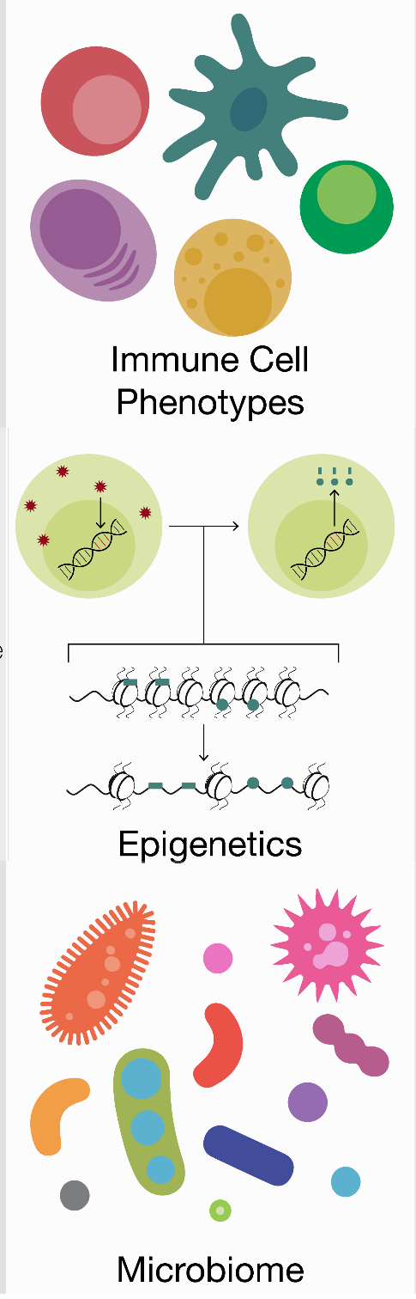

Sex differences in HIV
Distribution of immune
subsets
Immune activation
setpoints
Efficacy of antiviral responses
Hormonal modulation of function
Anatomic and hormonal microenvironment differences
Distinct epigenetic
landscapes
Differences in
establishing latency
Direct estrogen effect
on transcription and
latency
X chromosome gene dosage effects
(TLR7, FOXP3)
miRNA enrichment on the X chromosome
Hormone responsive promoter elements
Immune modulatory function
Microbiome in the
genital tract: direct
link with inflammation, acquisition risk/PrEP efficacy
Scully, Curr HIV/AIDS Rep, 2018

Slide 5
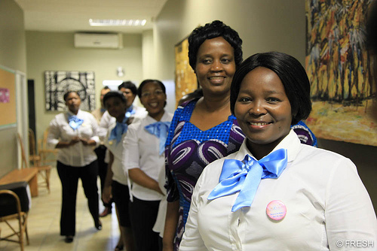
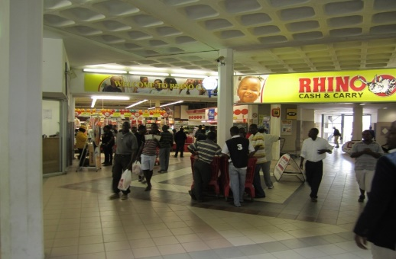
The FRESH cohort combines socioeconomic interventions and basic science
Goals: 1. HIV prevention; poverty reduction
2. Immunology of acute infection
3. Cure studies in women
Fiebig I/II Fiebig III-VI
HIV negative sexually active females are recruited
An empowerment curriculum coincides with twice weekly HIV screening
Blood, female genital tract samples and lymph node samples are collected
71 acute infections identified, 57 immediately treated with ART
Viral load
Time post-infection

Slide 6
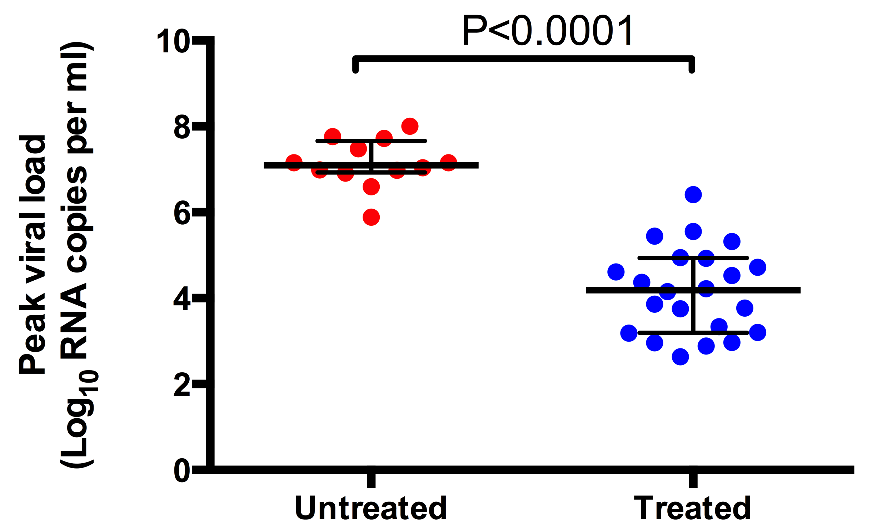
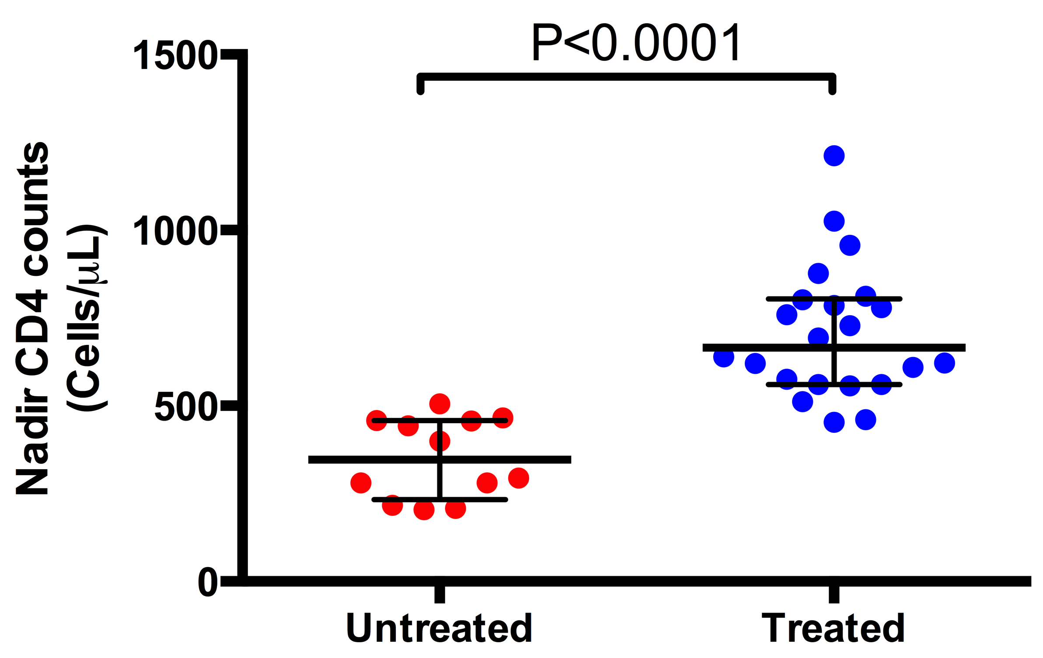
Treatment during Fiebig stage I blunts peak viremia and preserves CD4+ T cells
Dong et al, 2017, Lancet HIV

Slide 7
Total DNA reservoir is similar in early treated versus untreated participants at hyperacute infection phase

Slide 8
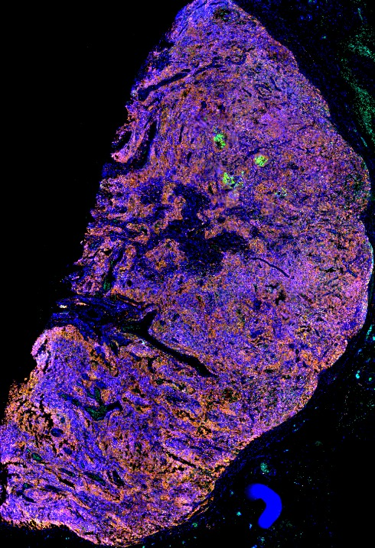
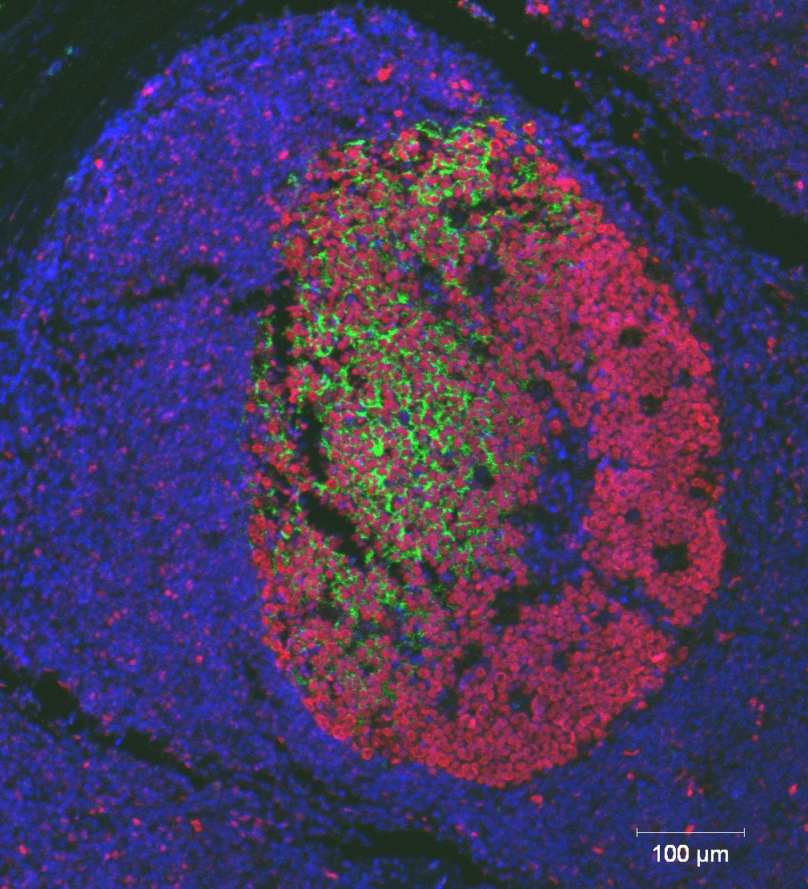
HIV persists in lymph nodes of immediately treated participants
p24+ cells co-localize with BCL6+
cells in the germinal centers
p24
BCL6
Acute 53 (PID 127-33-0942-683)
DAPI
CD4
Viral load
p24
BCL6
DAPI
Age: 19
VL: <20 cps/ml

Slide 9
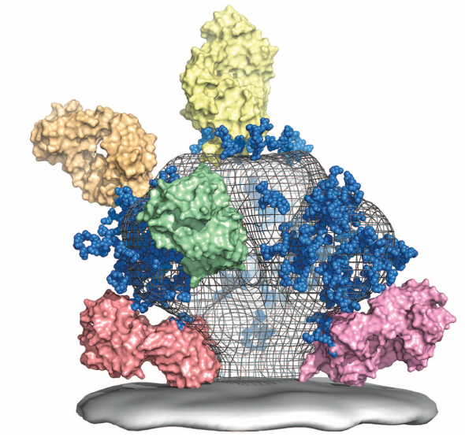
What about sensitivity of transmitted/founder virus to bNAbs?
C3/V3 (glycan dependent) –
2G12, PGT128, PGT121, PGT135
V1V2 (glycan dependent) – PG9, PG16, PGT141-145, CH01-04, CAP256-VRC26, PGDM1400
CD4 binding site b12, VRC01, 3BNC117, HJ16, NIH45-46, CH31, CH103, 12A12
gp120-gp41 interface (glycan dependent) PGT151, 35O22, CAP248 30.2B
MPER – 4E10, 2F5, z13, 10E8
Adapted from Burton et al, Science, 2012

Slide 10
No single bNAb neutralizes all the transmitted/founder viruses in FRESH with great potency
However, PGT151, PGT121, PGDM1400, and CAP256 show good coverage
bNab | T/F viruses |  |  |  |  |  |  |  |  |  | Subtype C Viruses
 | 093 | 208 | 268 | 079 | 318 | 036 | 271A | 271B | 267 | 186 | CAP45 | Du172 | CAP239 | ZM197
VRC01 | 0.59 | >10 | >10 | 2.18 | 0.92 | 0.23 | 0.32 | 6.37 | 1.33 | 0.4 | >10 | >10 | >10 | 0.72
PGT151 | 0.06 | 0.02 | 0.03 | 0.02 | 0.2 | <0,005 | 0.06 | 0.04 | 1.52 | 0.01 | 0.02 | 0.02 | 0.04 | 0.03
10 E8 | 0.64 | 1.31 | 0.51 | 1.4 | 0.52 | 0.91 | 1.05 | 2.43 | 0.17 | 0.5 | 0.16 | 0.03 | 0.34 | 0.18
PGDM1400 | 0.09 | 0.3 | 9.29 | <0,005 | >10 | <0,005 | >10 | <0,005 | <0,005 | 0.01 | <0,005 | 1.63 | <0,005 | 0.07
PGT121 | <0,005 | 0.04 | 0.06 | >10 | 0.02 | <0,005 | >10 | >10 | 0.09 | 0.02 | >10 | 0.01 | <0,005 | >10
3BNC117 | >10 | 0.06 | >10 | >10 | 0.06 | 0.07 | 0.55 | >10 | 0.14 | 0.1 | 0.85 |  | >10
CAP256 | 0.01 | 0.46 | >10 | <0.005 | <0.005 | 5.48 | 0.19 | <0.005 | <0.005 | <0.005 | <0.005 |  | <0.005
SK POOL | 1006 | 101 | 186 | 2477 | 1832 | 945 | 203 | 1388 | 478 | 504 | 2544 | 337 | 1056 | 535
 |  |  |  |  | <0,1 µg/ml
 |  |  |  |  | 0,9 - 0,1
 |  |  |  |  | 3,0 - 0,91
 |  |  |  |  | 10,0 -3,1
 |  |  |  |  | >10

Slide 11
Will combined interventions work as a functional cure strategy?
Adjuvants and LRAs
TLR agonists
Low reservoir, preserved immune function
Early, intensified ART initiated during acute infection phase
Sanctuary disruption and immune modulation
bNAbs
HIV remission?

Slide 12







Acknowledgements
AHRI and HPP- UKZN
Krista Dong
Amber Moodley
Zaza Ndhlovu
Kavidha Reddy
Omolara Baiyegunhi
Jenn Mabuka
Bongiwe Ndlovu
Kamini Gounder
Daniel Muema
Nasreen Ismael
Prince Mshiyeni Hospital
Johann Pansegrouw
FRESH study participants
FRESH study team
Colleagues who have shared slides and ideas
Harvard/MGH
Bruce Walker
Douglas Kwon
Musie Ghebremichael
University of Oxford
Philip Goulder
Funding
Bill and Melinda Gates Foundation
IAVI
NIH
South African DST/NRF
HHMI
Gilead Sciences, Inc.

